Slide 1
Introduction to UML
Behavioral Diagrams
Data Modeling

Slide 2
Introduction
Behavioral Diagrams
Use Case Diagram
Sequence Diagram
State Diagram
Activity Diagram
Collaboration Diagram
Data Modeling
Entities
Attributes
Relationships

Slide 3

Behavioral Diagrams

Slide 4

Behavioral Diagrams
Interactions
Functionality
Verbs and Actions

Slide 5
Use Case Diagram
User Tasks
System Interactions
What not How
Pay Bill
Customer
<<include>>
Payment Processing Service
<<extend>>
Authenticate User
Schedule Recurring Payment
Skip Scheduled Payment
Manage Scheduled Payment
Terminate Scheduled Payment

Slide 6








Common Users of Use Case Diagrams
Product Owner
Business Analyst
Architec t
Operations
Quality Assurance
Developer

Slide 7
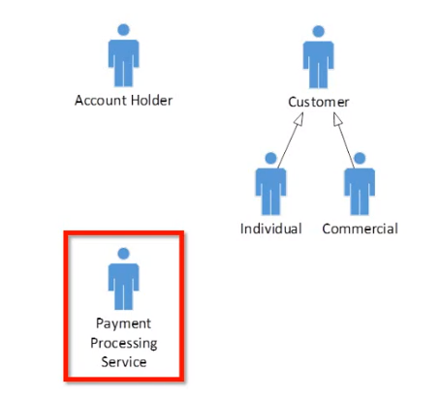
Actors
People
□ Roles
Generalization
Systems

Slide 8
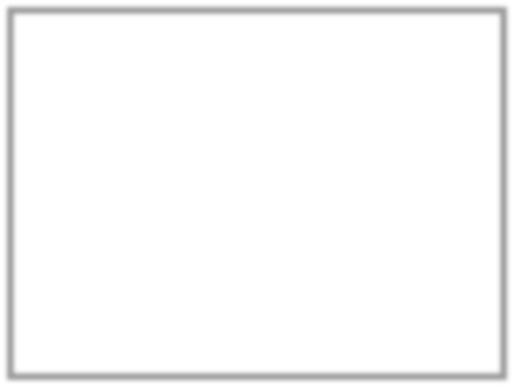
Use Cases
Simple name
User Tasks
System Interactions
Factor out common processes (<<include>>)
Identify optional additions (<<extend>>
Generalize
Pay Bill
<<include>>
Authenticate User
<<include>>
<<extend>>
Schedule Recurring
Payment
Process Loan Request
Fixed Interest Loan
Variable Interest Loan

Slide 9
Scenarios
One Use Case may have many scenarios
Scenario
Steps in process
Branches
Extensions
Exceptions
Use Case vs. Use Case Diagram
Pre-Conditions
Post-Conditions
May Relate to User Stories
Pay Bill

Slide 10



Basic Use Case Diagram
Pay Bill
Customer
<<include>>
Payment Processing Service
<<extend>>
Authenticate User
Schedule Recurring Payment
Skip Scheduled Payment
Manage
Scheduled Payment
Terminate Scheduled Payment

Slide 11
Sequence Diagram
Object Interaction
Focus on time/order
WebClient AccountSvc
SchedulePayment()
Account
Payee
Scheduler
Processor
Verify()
opt
ValidAccount
GetDetails()
GetPayments
opt
FirstPayment
SendZeroValueTestPayment()
ScheduleFuturePayment()

Slide 12


Common Users of Sequence Diagrams
Business Analyst
Product Owner
Architec t
Operations
Quality Assurance
Developer

Slide 13


Classes
Lifeline
Focus of Control
Object Lifetime
Creation
Termination
Account
Account
Create()
Account
Destroy()

Slide 14
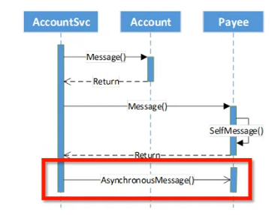
Messages
Message
Return
Self Message
Asynchronous

Slide 15
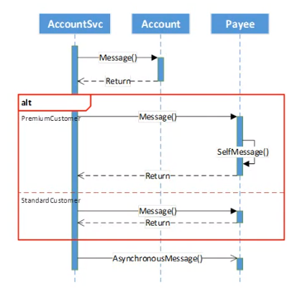
Structured Control
Looping
Optional
Conditional
□ [else]
Parallel

Slide 16
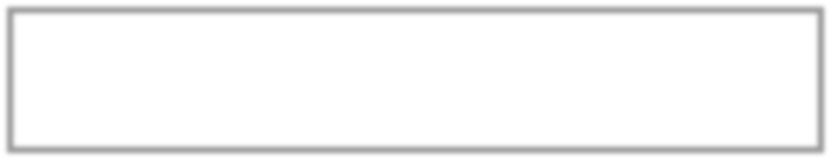
Basic Sequence Diagram
WebClient AccountSvc
SchedulePayment()
Account
Payee
Scheduler
Processor
Verify()
opt
ValidAccount
GetDetails()
GetPayments
opt
FirstPayment
SendZeroValueTestPayment()
ScheduleFuturePayment()

Slide 17
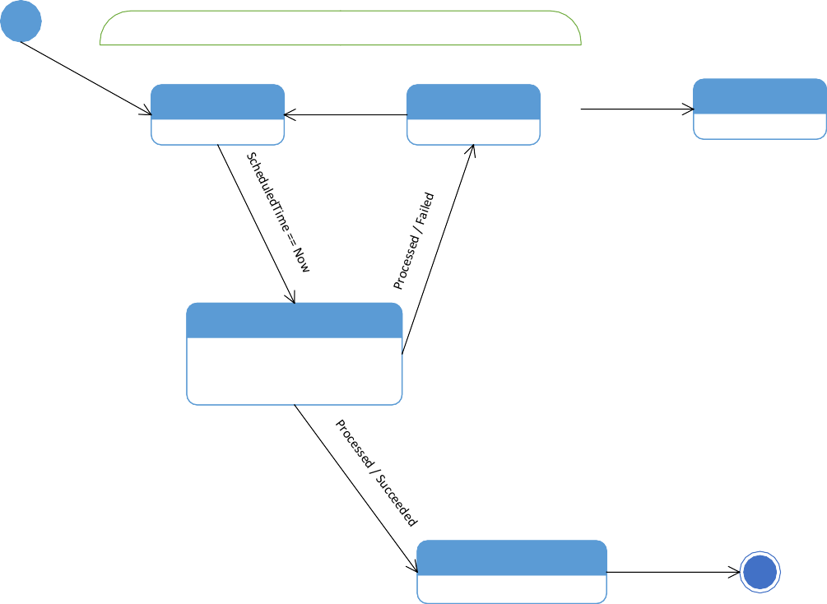
State Diagram
Model states of an object
Reactive objects
Idle
Scheduled
Reschedule
Faulted
Cancel
Cancelled
Processing
entry / logPaymentAttempt() do / waitForConfirmation() exit / logConfirmation
Completed
entry / notifyCustomer()

Slide 18


Common Users of State Diagrams
Business Analyst
Product Owner
Architec t
Operations
Quality Assurance
Developer

Slide 19
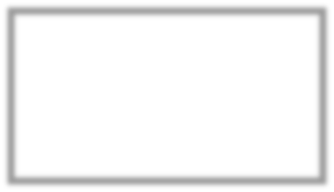

States
Basic
Internal Behavior
Special
Initial
Final
Scheduled
Processing
entry / logPaymentAttempt() do / waitForConfirmation() exit / logConfirmation

Slide 20




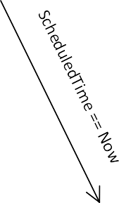
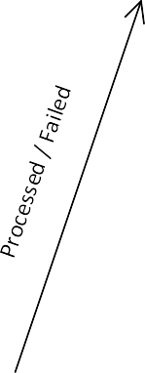
Transitions
Basic
Transition
Event
Scheduled
Reschedule
Faulted
Processing
entry / logPaymentAttempt() do / waitForConfirmation() exit / logConfirmation

Slide 21
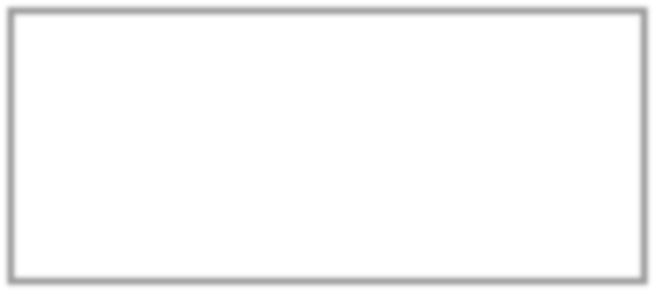

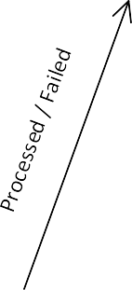

Composite State
Idle
Scheduled
Reschedule
Faulted
Cancelled
Processing
entry / logPaymentAttempt() do / waitForConfirmation() exit / logConfirmation

Slide 22
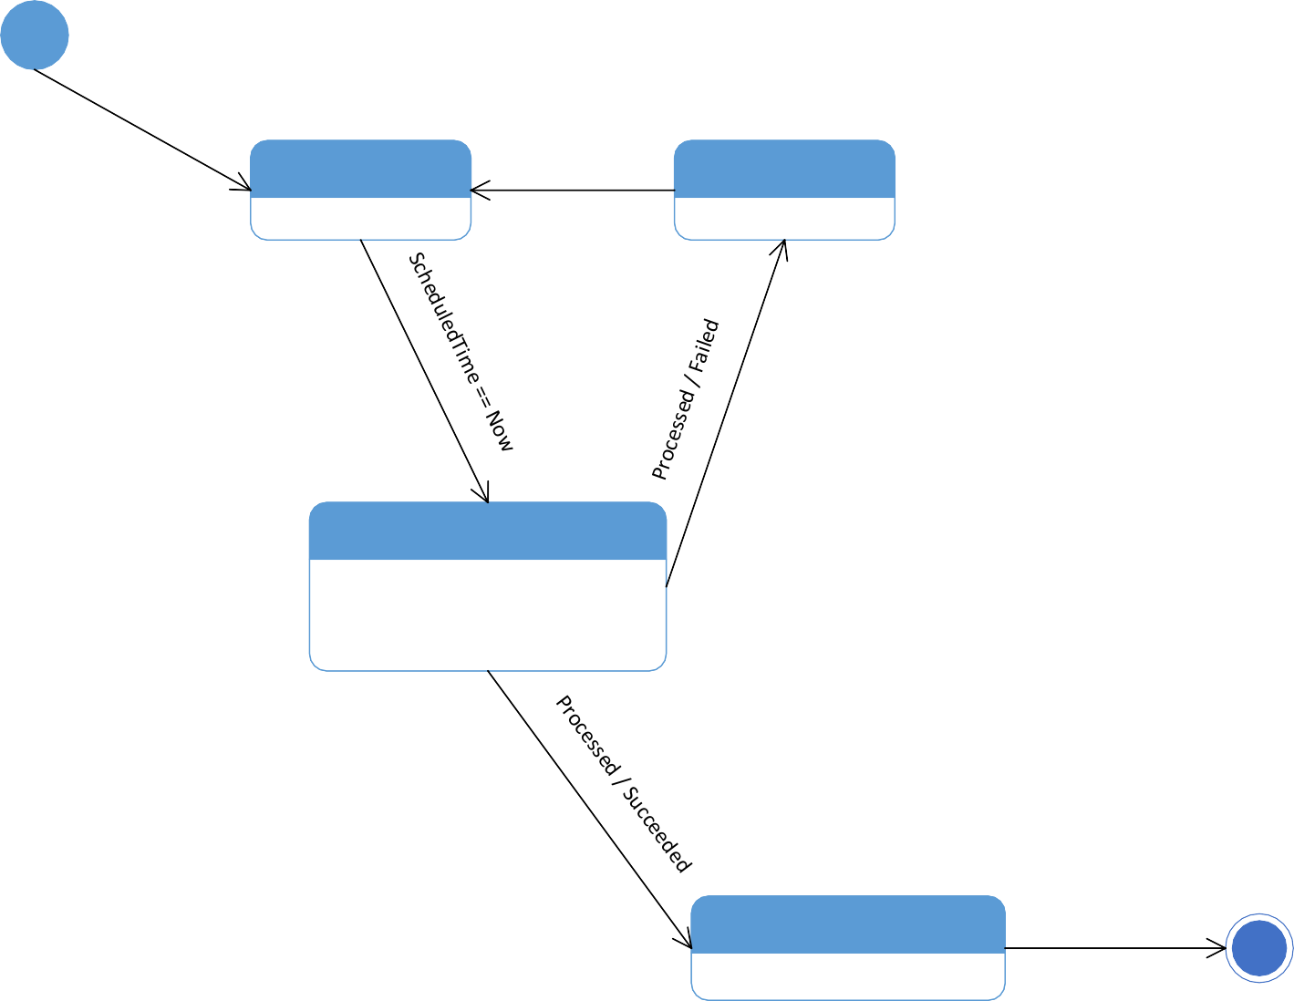
Basic State Diagram
Idle
Scheduled
Reschedule
Faulted
Cancel
Cancelled
Processing
entry / logPaymentAttempt() do / waitForConfirmation() exit / logConfirmation
Completed
entry / notifyCustomer()

Slide 23
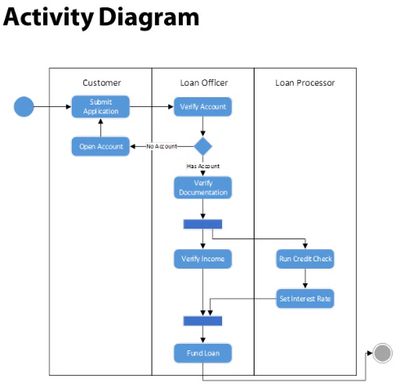
Activity Diagram
Workflows
Operations

Slide 24
Common Users of Activity Diagrams
Product Owner
Business Analyst
Architec t
Operations
Quality Assurance
Developer

Slide 25

Actions and Activities
Actions
Single Step
Activity
Multiple Step
□ Decomposed in own diagram
Special
Initiation
Completion
Submit Application

Slide 26
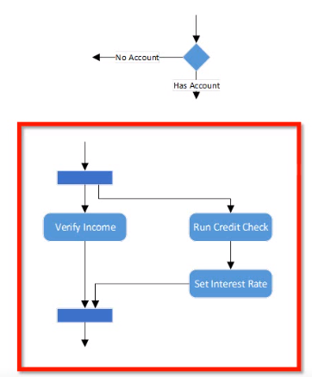
Flow Control
Decision / Branch
Fork and Join

Slide 27
Basic Activity Diagram

Slide 28
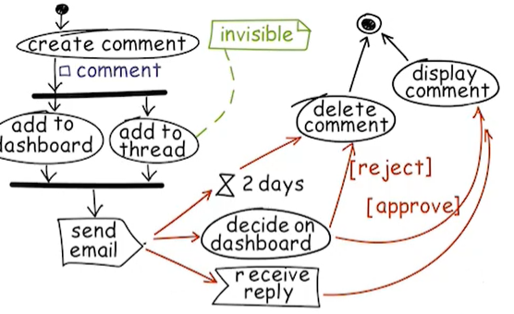

Collaboration Diagram

Slide 29
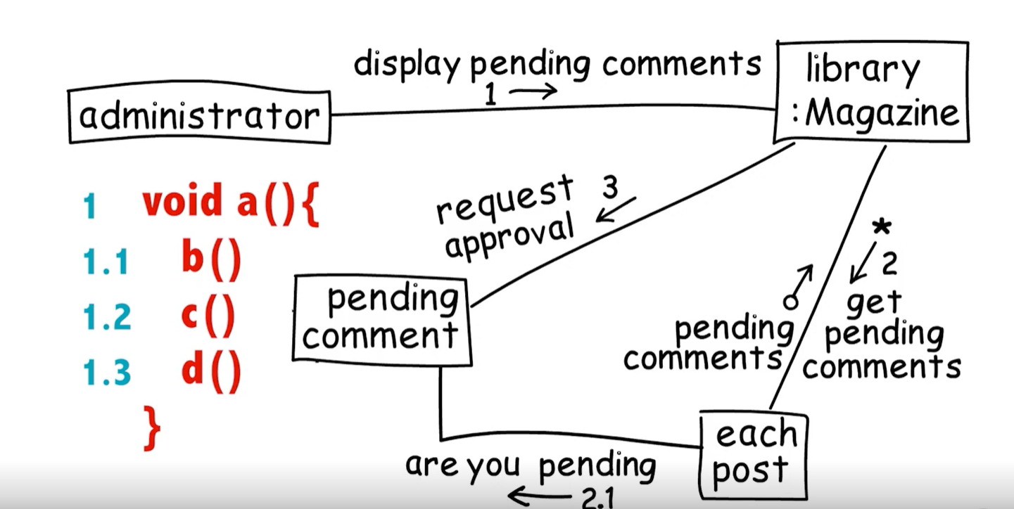
Collaboration Diagram

Slide 30
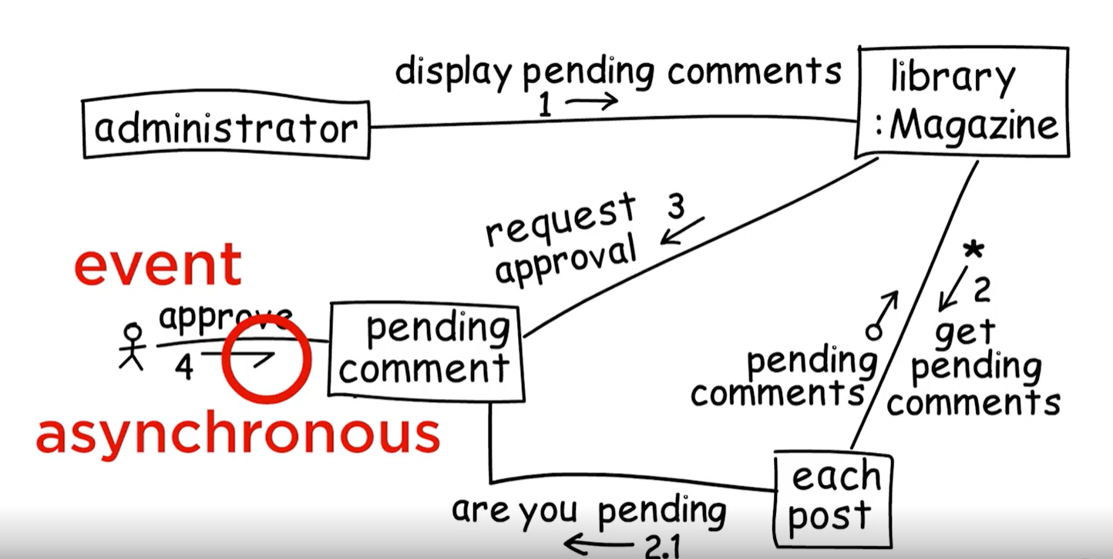
Collaboration Diagram

Slide 31
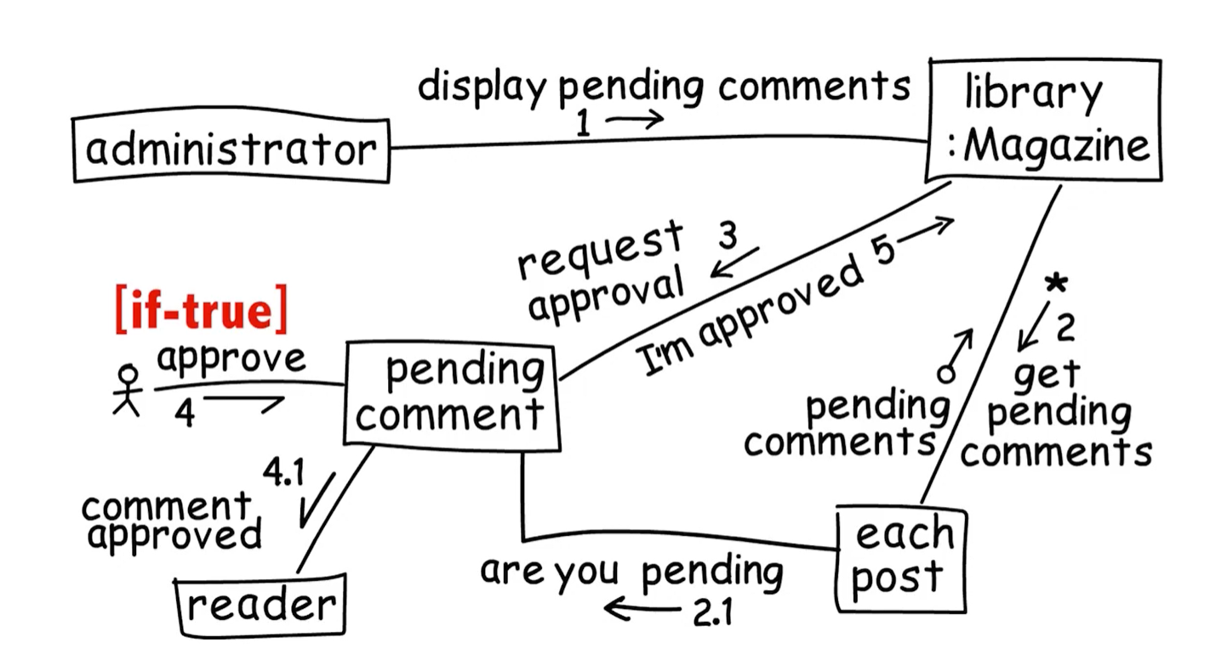


Collaboration Diagram

Slide 32
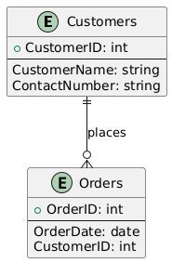
Data Modeling and Entity-Relationship (ER) Diagrams
Entities
Attributes
Relationships
Components of an ER Diagram:
Entities
Attributes
Relationships
Primary Key
Foreign Key

Slide 33
Summary
Behavioral Modeling
System Logic
Algorithms
Flows
Use Case Diagrams
Functionality / Features
Sequence Diagrams
Time ordered messages between objects
State Diagrams
Transitions between states for an object
Activity Diagrams
Enhanced flowchart
Data Modeling
Entities
Attributes
Relationships

